Slide 1
S&T Connect & Instructors
Kristin Salas, Sr. Director of Academic Advising – Academic Enrichment & Achievement

Slide 2
Overview
Purpose of S&T Connect
Instructors Tools
Enrollment Verification Survey

Slide 3
Purpose of S&T Connect
Instructors
Student
Campus Support Services
S&T Connect provides an integrated connection between instructors, students, and campus support services.

Slide 4
Instructors Tools

Slide 5

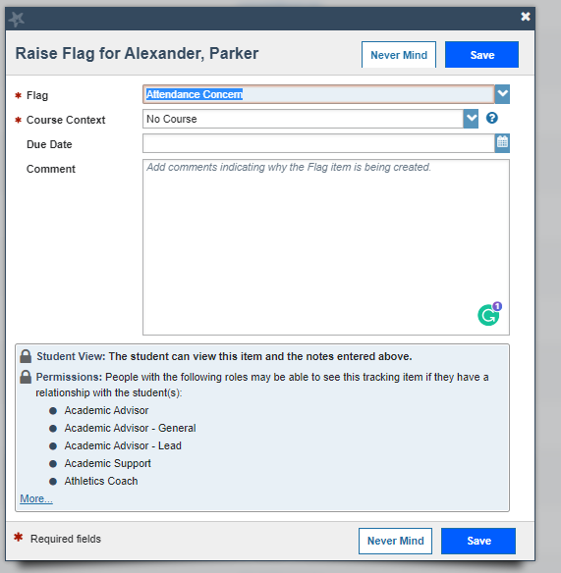
Flag
Allows instructors to raise concerns about a student.
  Behavioral
  Attendance Concerns
  Grades/Assignments
  Poor Class Performance
  Other
Students receive notice of flag except for (Behavioral).

Slide 6
Flag | Response
Attendance Concern | Student receives notification from instructor
Attendance Warning | Student and Academic Advisor receive email
Behavioral Concern | Student Support & Community Standards Receive Notification and outreach to student (Student does not get notified)
General Concern-Student | Student receives notification from instructor
In Danger of Failing | Student & Academic Advisor Receive Notification. Advisor typically follow up.
Low Quiz/Test Score | Student receives notification from instructor
Missed Assignment | Student receives notification from instructor
Poor Class Performance | Student receives notification from instructor

Slide 7

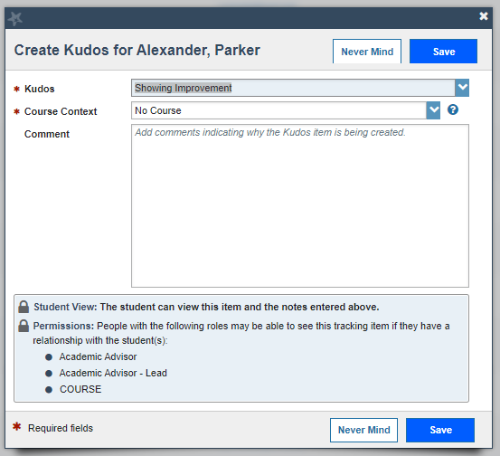
Kudos
Allows students to receive positive feedback for improvements.
  Outstanding Academic Performance
  Keep up the Good Work
  Showing Improvement
  Recommend to become an academic tutor

Slide 8
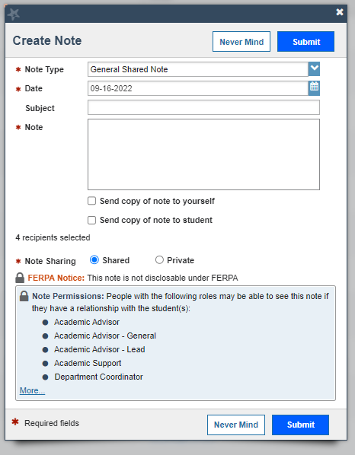
Notes
Allows for communication between instructor and academic advisor.
Creates documentation for conversations with students concerning courses or advisement.

Slide 9
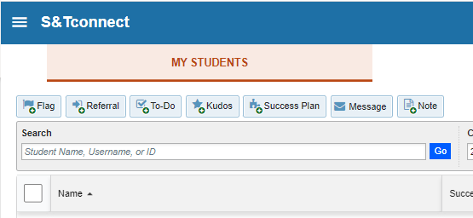
Other Items
Referrals
  Connects students with service providers (e.g., tutoring)
Message
  Allows instructors to email students or entire course.

Slide 10
Progress Surveys:
Enrollment Verification

Slide 11
Progress Survey
Used for course verification survey by the Registrar’s Office and Academic Achievement & Enrichment
Ask instructors to verify certain information for students within their course by raising a flag.
Flag triggers intervention from campus service provider

Slide 12
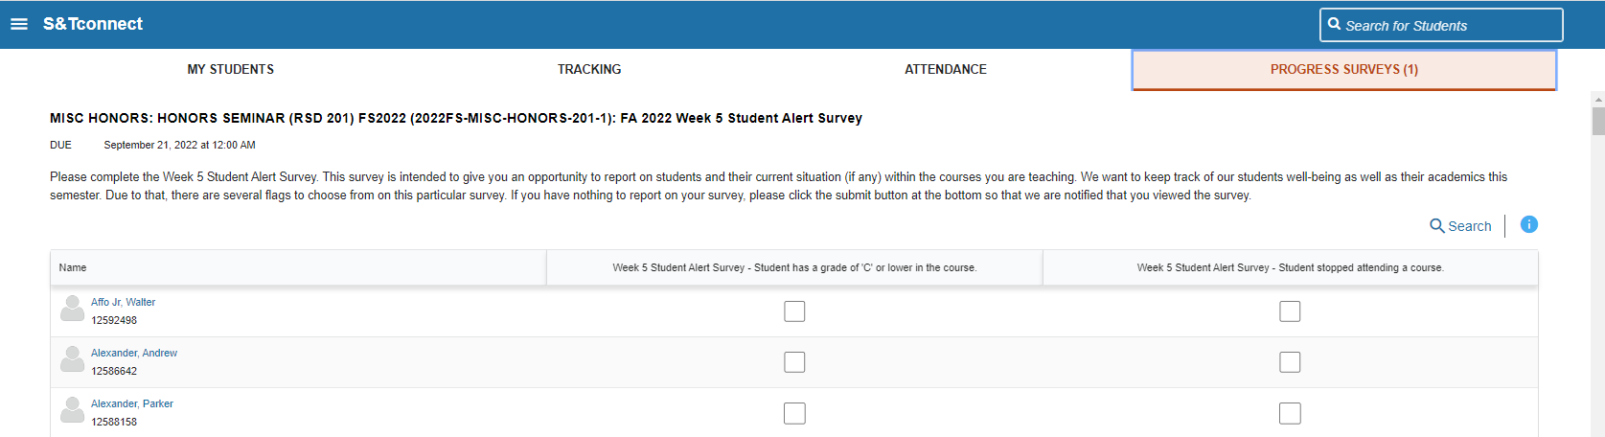
Progress Survey

Slide 13
Enrollment Verification Survey
Regular 16-week Session ​
Open survey: January 30
Reminder: February 6
Survey closes: February 10
Purpose: To verify students’ enrollment in courses per Department of Education regulations.
Process: Mark students who have not attended or stopped attending class. Students are notified and the Registrar’s Office will remove them from the course within 2 business days.
First 8-week Session ​
Open survey: January 27
Survey closes: February 2
Second 8-week Session ​
Open survey: March 23
Survey closes: March 27

Slide 14
Week-5 Academic Alert Survey
Purpose: To identify students who are struggling academically and connect them with appropriate campus support services.
Time Frame: Wednesday, February 11 to Sunday, February 22.
Process: Mark students who have a ‘D’ or lower in the course, accompanied by concerns regarding their potential to improve. Students are notified of the flag, academic advisors will follow up, and other student support services will connect as well.

Slide 15
S&T Connect
For additional trainings or 1-1 consultations
Contact:
Kristin Salas, Senior Director of Academic Advising at 573.341.7276
ksalas@mst.edu

